Slide 1



T2307A-FPT Aptech Hanoi
Group 2
Website:
DNBC - News and Reporting

Slide 2
01
03
Đặng Hồng Quân
Tô Xuân Bách
02
04
Đỗ Thị Diệp Quyên
Nguyễn Anh Ngọc
Team Member

Slide 3
Introduction
The thirst for learning, upgrading technical skills and applying concepts in real-life environments at a fast pace is what the industry demands from IT professionals today. However busy work schedules, far-flung locations, and unavailability of convenient time slots pose major barriers when it comes to applying the concepts into realism. Hence the a need to look out for alternative means of implementation in the form of a laddered approach.
The above truly poses as constraint, especially for our students too! With their busy schedules, it is indeed difficult for our students to keep up with the genuine and constant need for an integrated application which can be seen in life especially so in the field of IT education where technology can change on the spur of a moment. Well, technology does come to our rescue at such times!!
Keeping the above in mind and in tune with our constant endeavour to use Technology in our training model, we at Aptech have thought of revolutionizing the way our students learn and implement the concepts using tools themselves by providing a live and synchronous eProject learning environment!

Slide 4
TECHNOLOGY
React JS
1
HTML CSS
3
2
Bootstrap
JavaScript
4

Slide 5
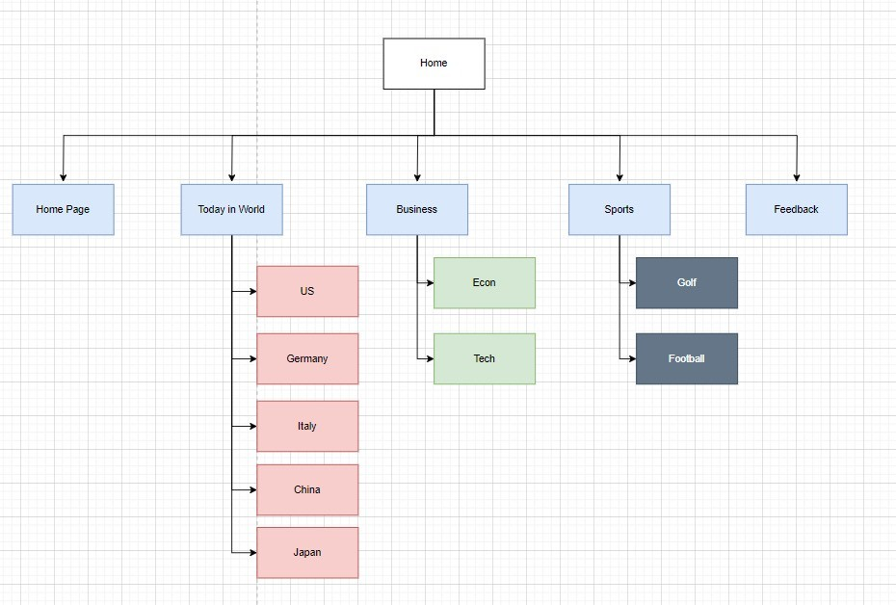
Site Map

Slide 6
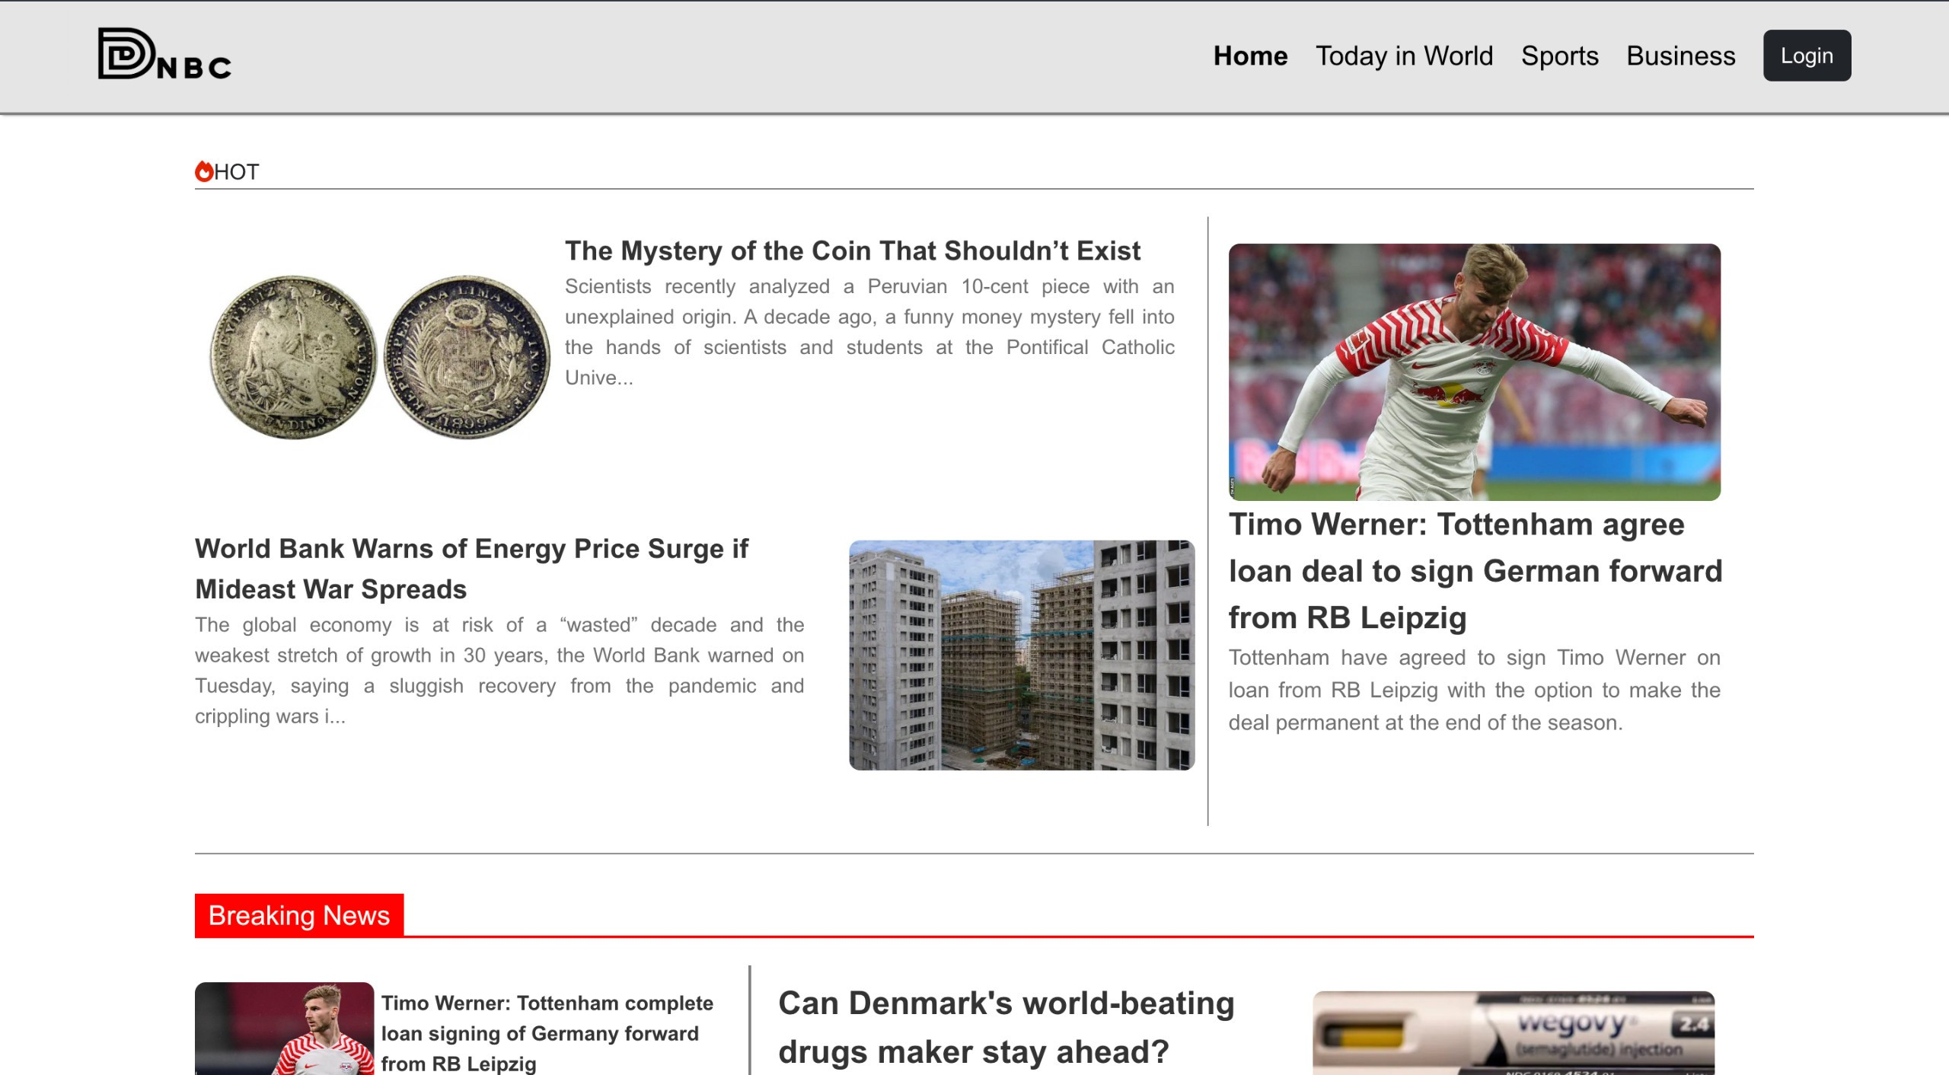
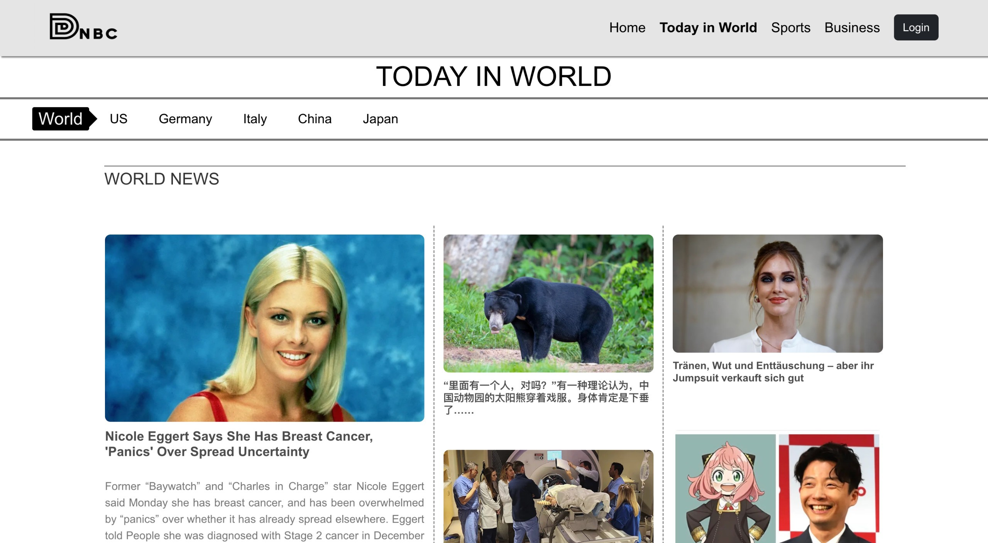
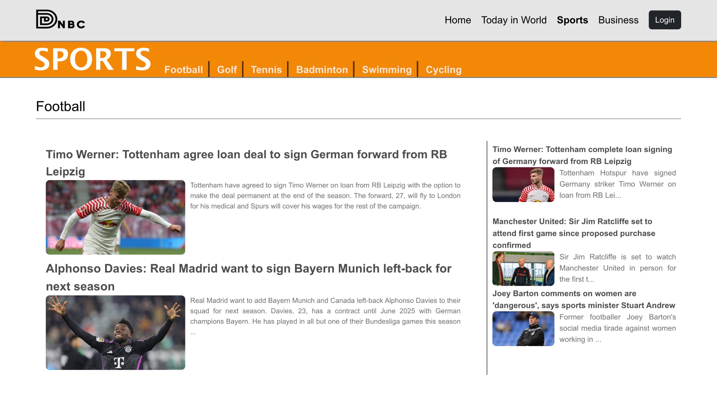
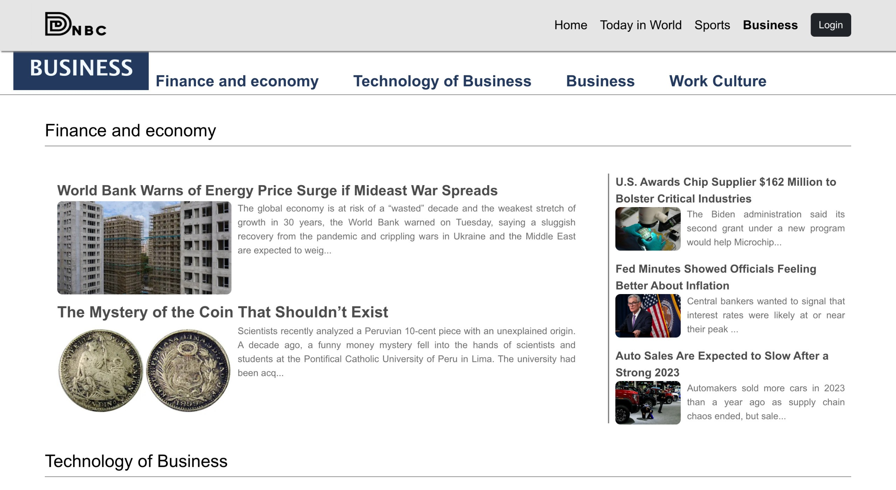
MAIN SCREENS

Slide 7
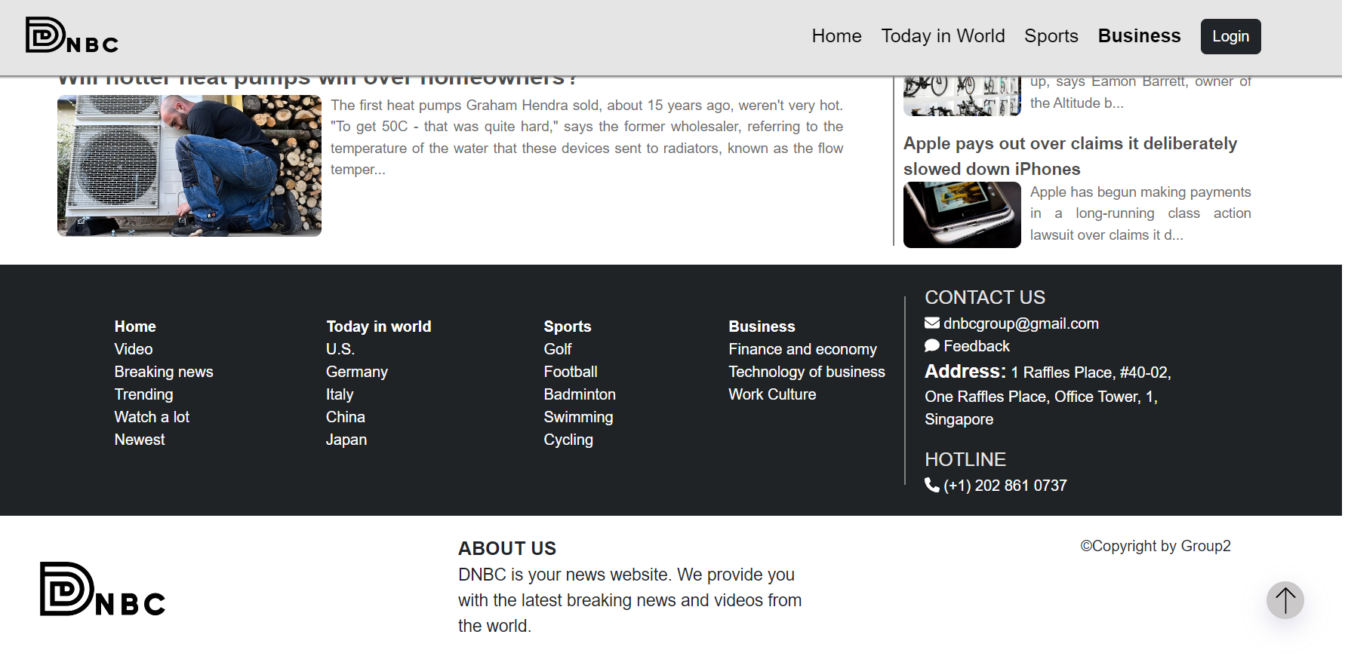
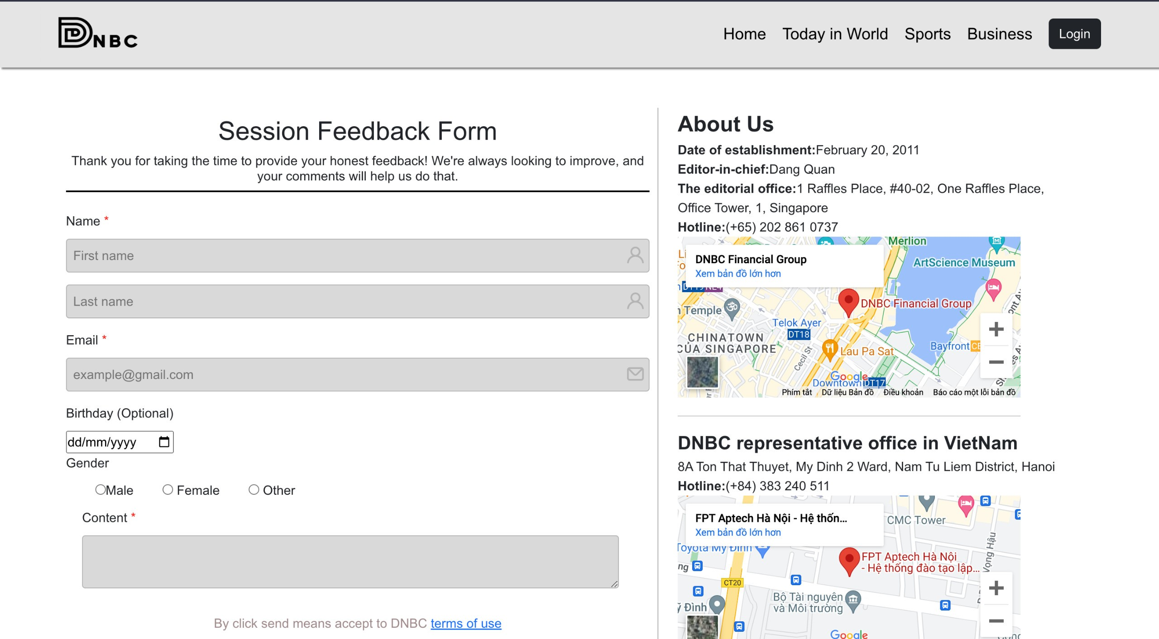
Footer
Feedback Form

Slide 8
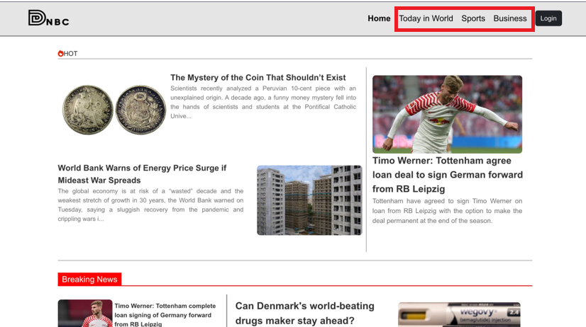
We categorize the news into various sections

Slide 9
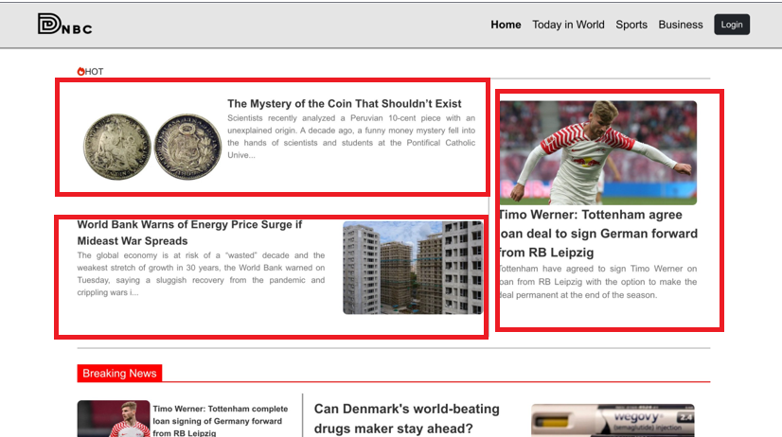
Including a piece of information in an article can assist readers in comprehending its contents better.

Slide 10
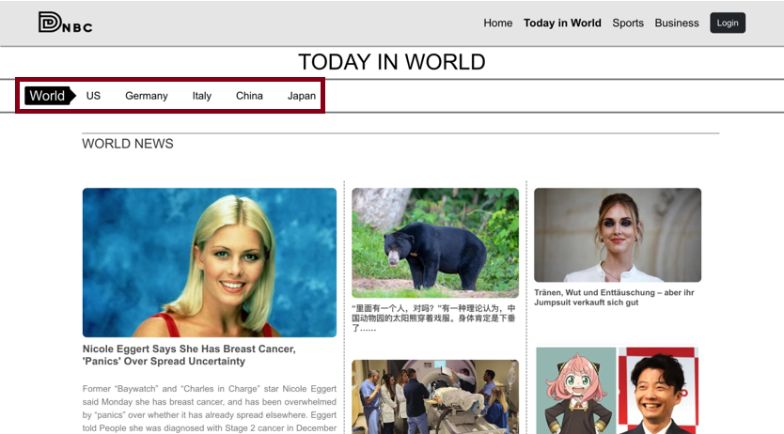
On our "Today in the World" page, we have categorized countries according to their respective languages.

Slide 11
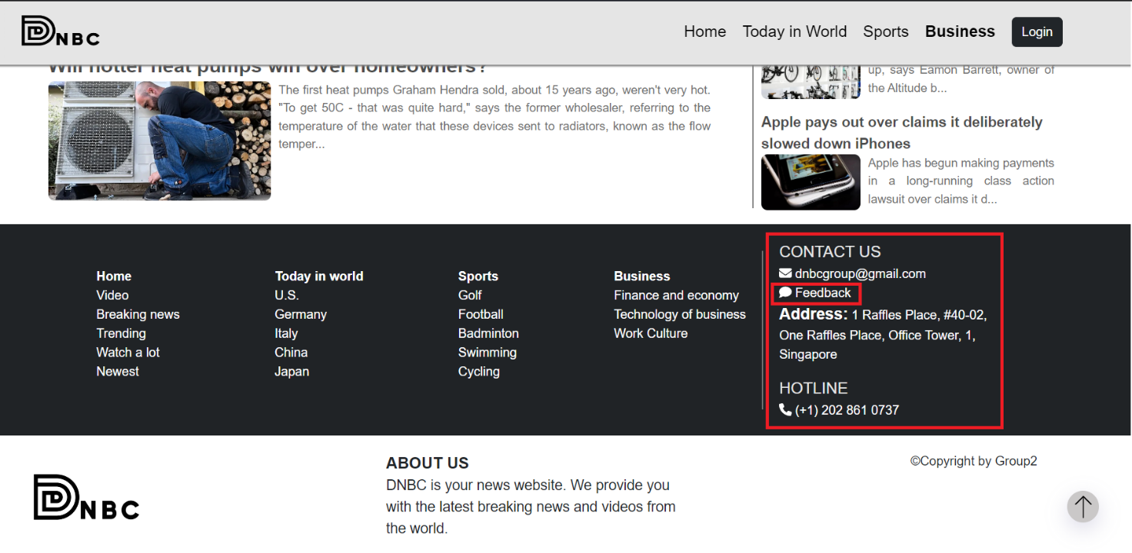
We have "Contact Us" and "Feedback" sections available in the footer of every webpage.

Slide 12
When you click on the feedback button, it will take you to the feedback page.

Slide 13
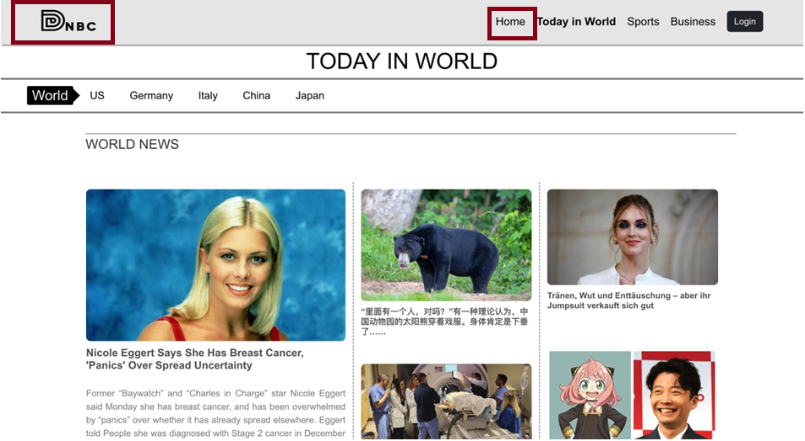
To return to the homepage, you can click on either the home button or the website logo.

Slide 14
T2307A-FPT Aptech Hanoi
Group 2
That's it. Thank you for watching

